Slide 1



Library Management System

Slide 2
Introduction
The Library Management System is designed to efficiently manage books, borrowers, and library branches using a structured relational database in MySQL.
It maintains comprehensive records of publishers, authors, book inventory across multiple branches, and the allocation of book copies per branch.
The system tracks borrowers along with their borrowing history, including book loans with issue and due dates to enable easy monitoring of book circulation.
Key functionalities include querying book availability by branch, tracking overdue books, and generating reports on borrowers and book loans.
The project utilizes normalized database tables with primary and foreign keys to ensure data integrity and support complex queries joining multiple entities.
This system enhances operational efficiency by automating book tracking, borrower management, and library reporting processes for improved decision-making.

Slide 3

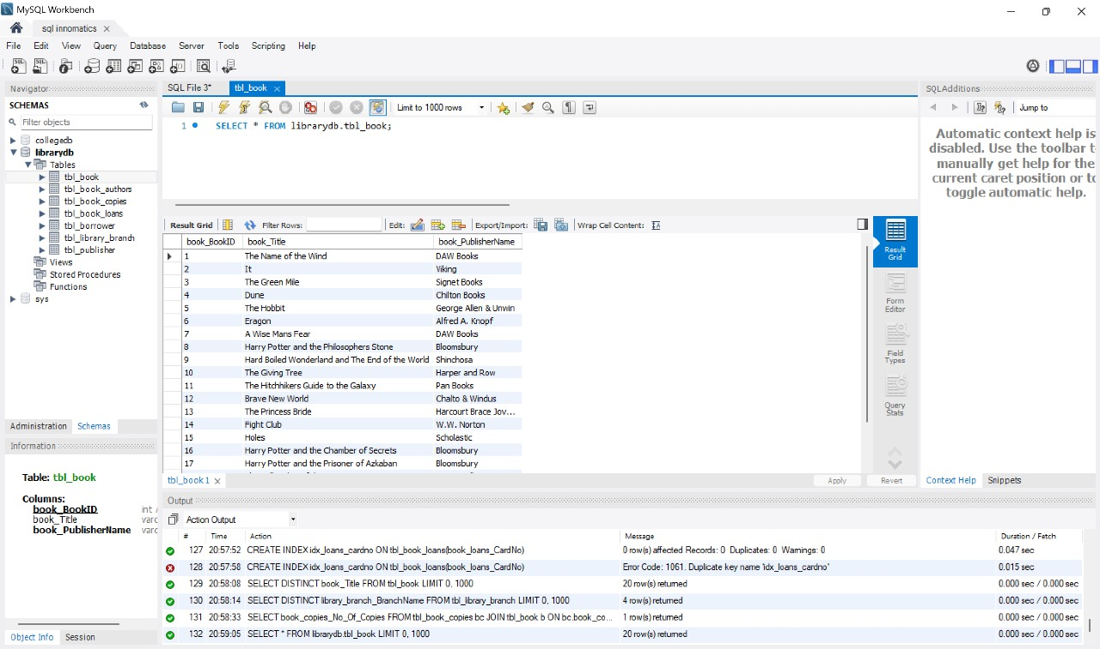
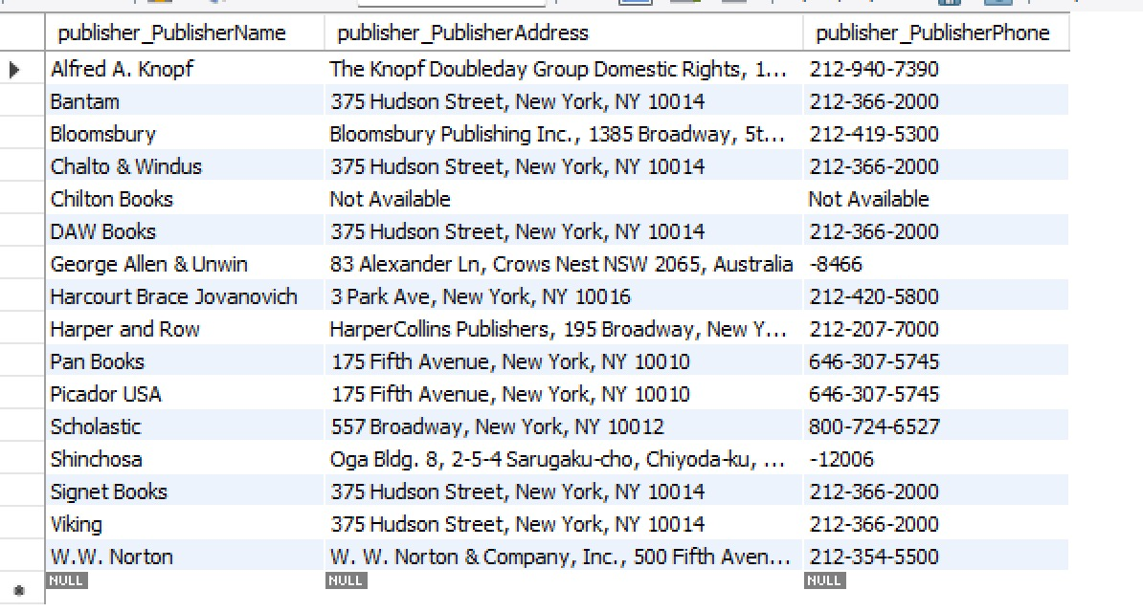
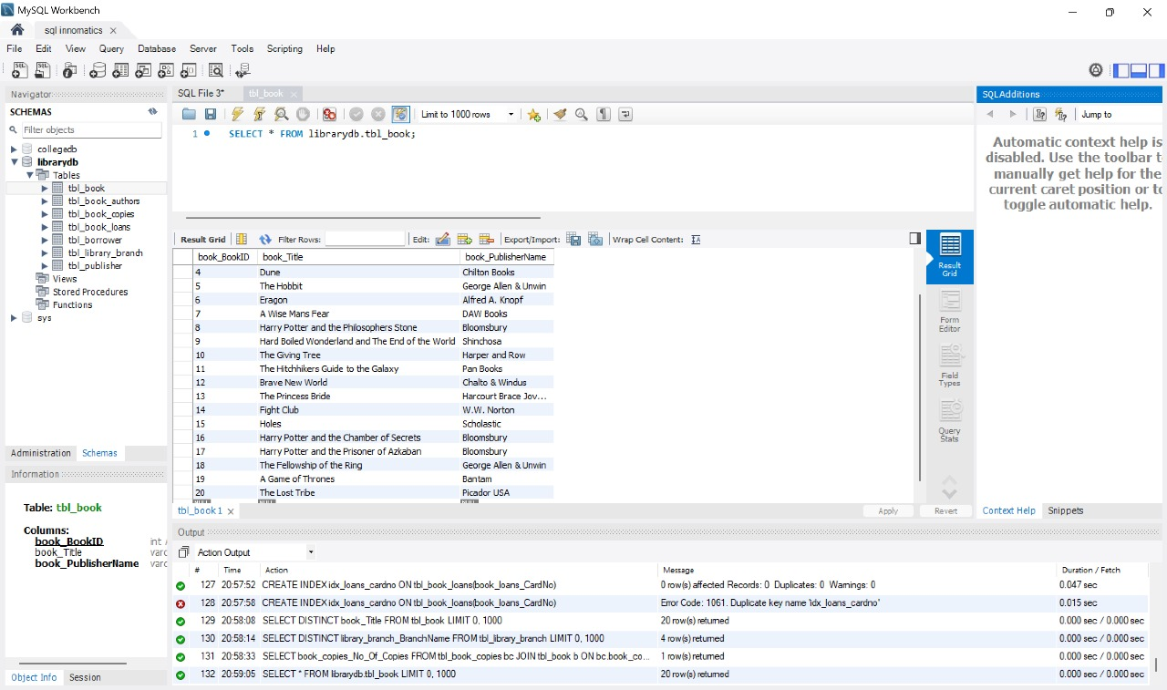
Tables
Publisher
Books

Slide 4
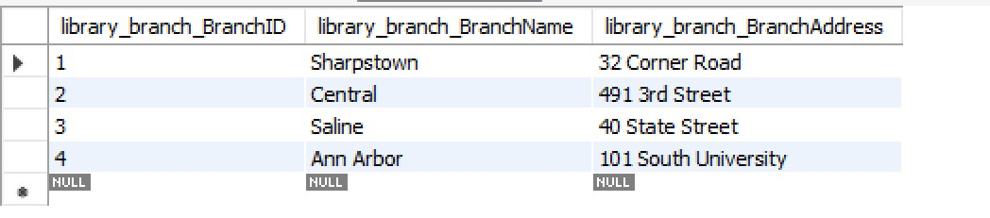
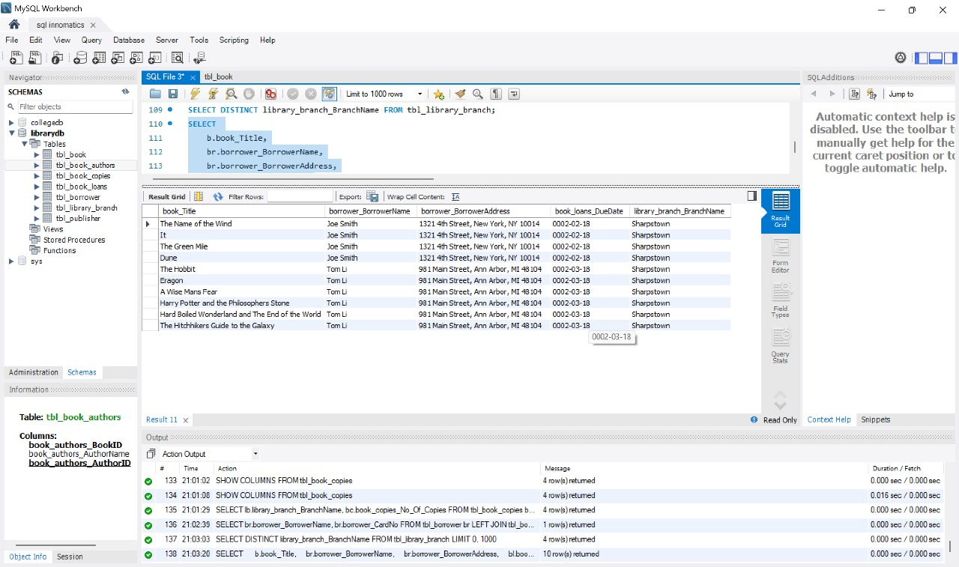

Library Branch
Borrowers

Slide 5

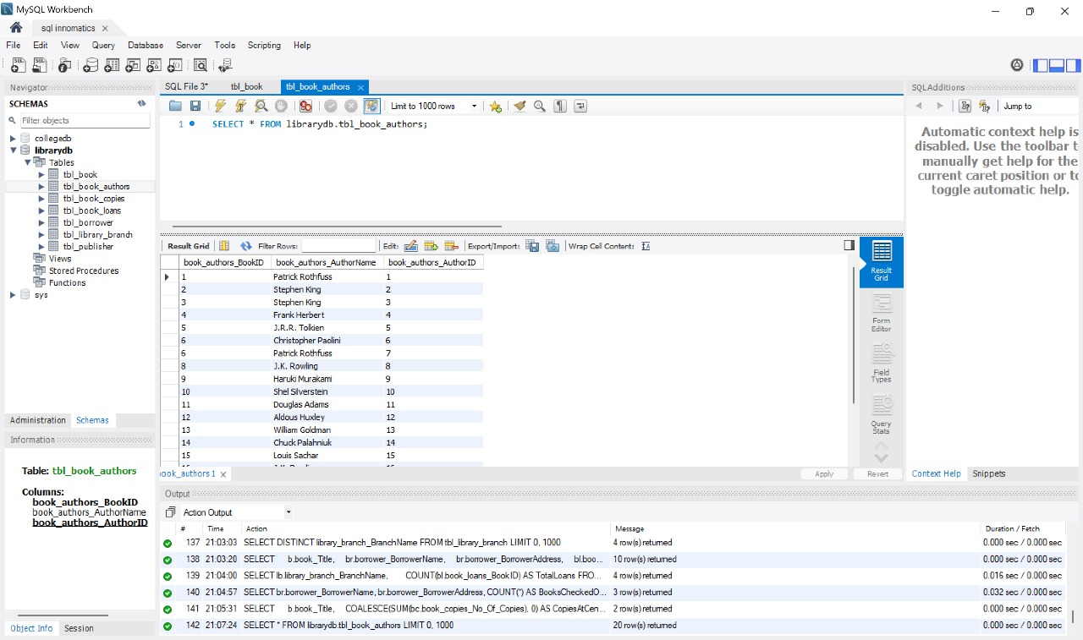
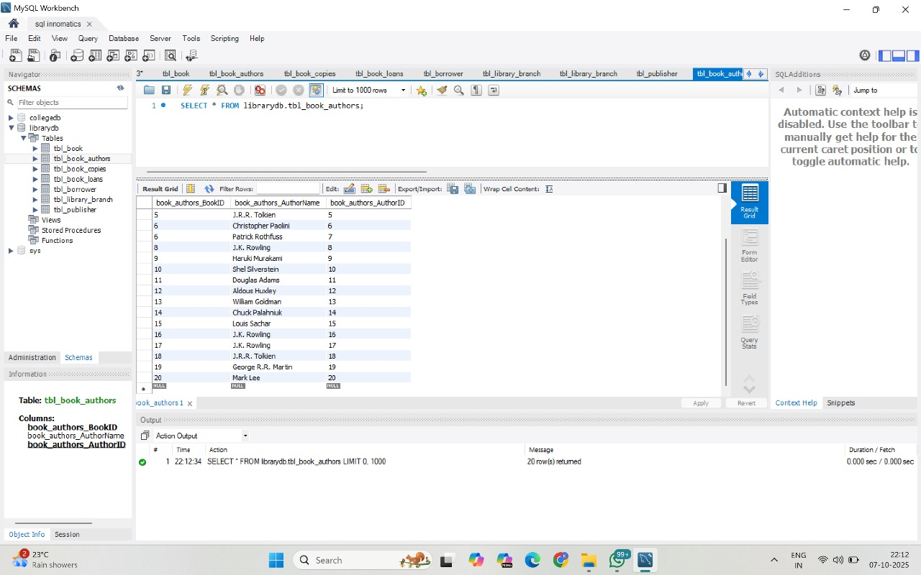
Book Author

Slide 6
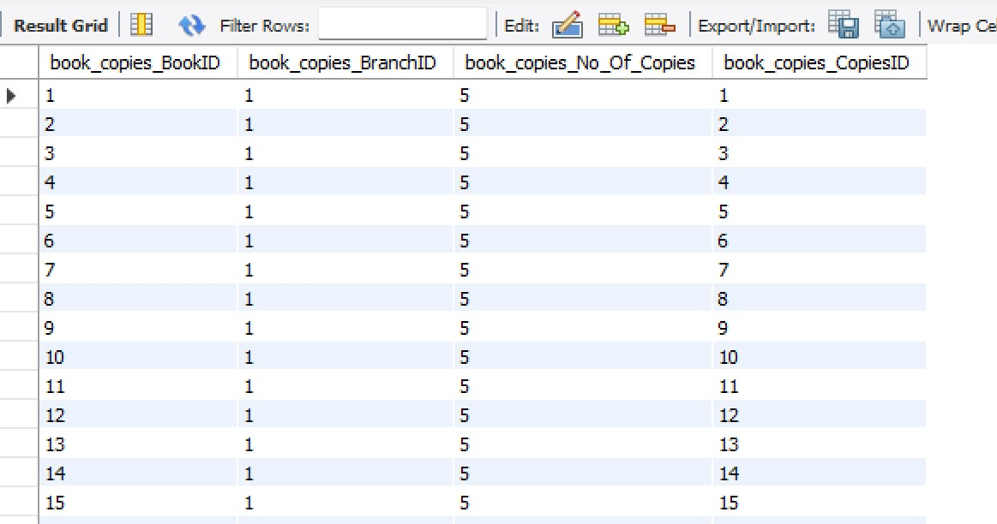
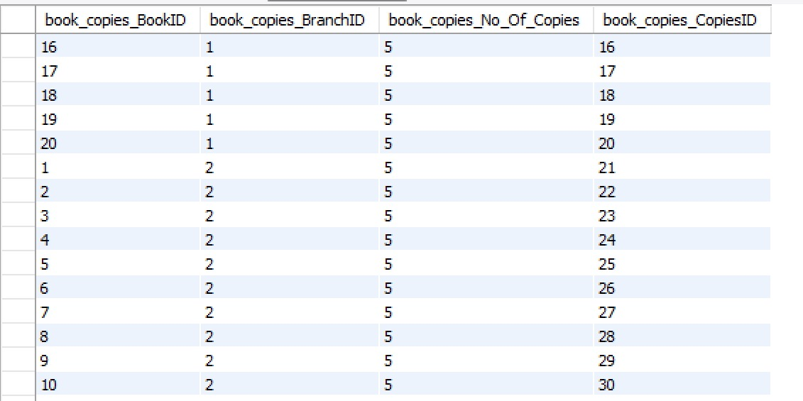
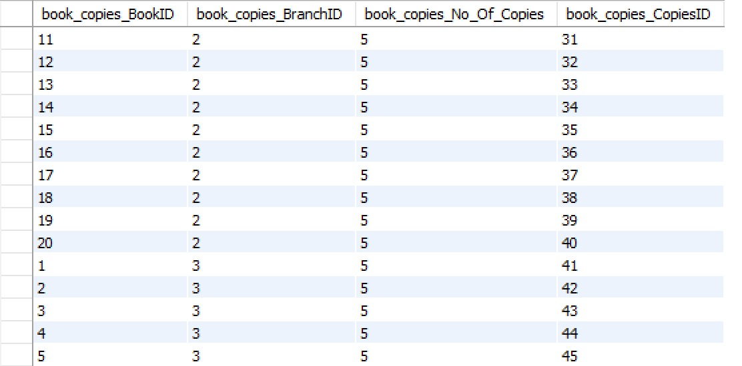
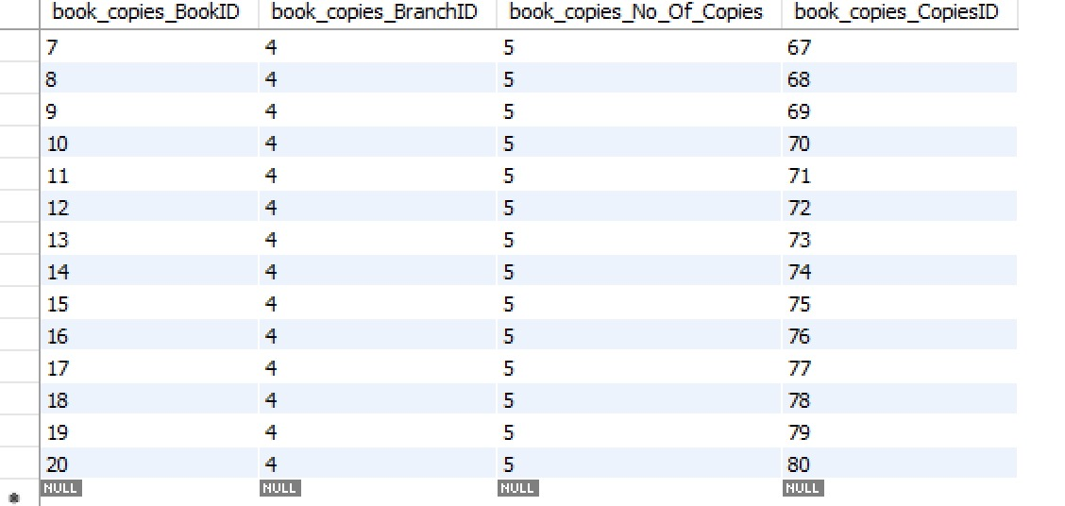

Book Copies

Slide 7

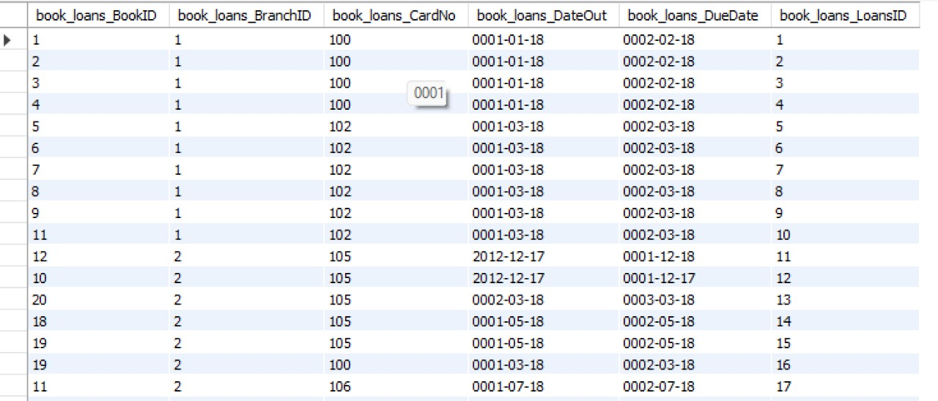
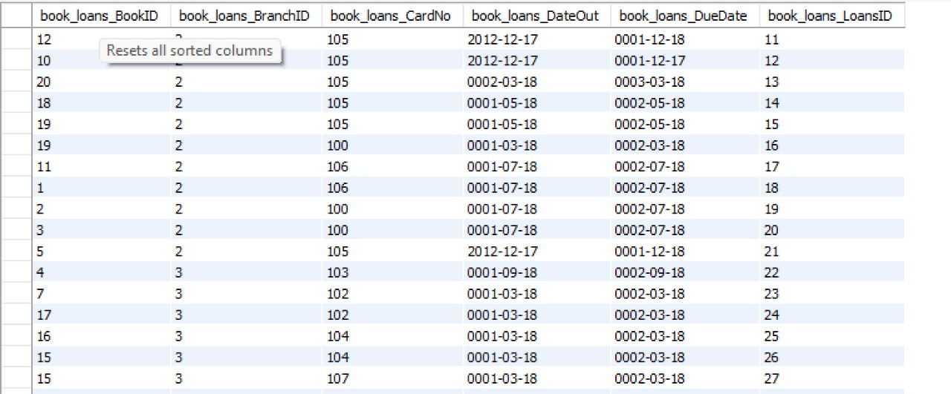
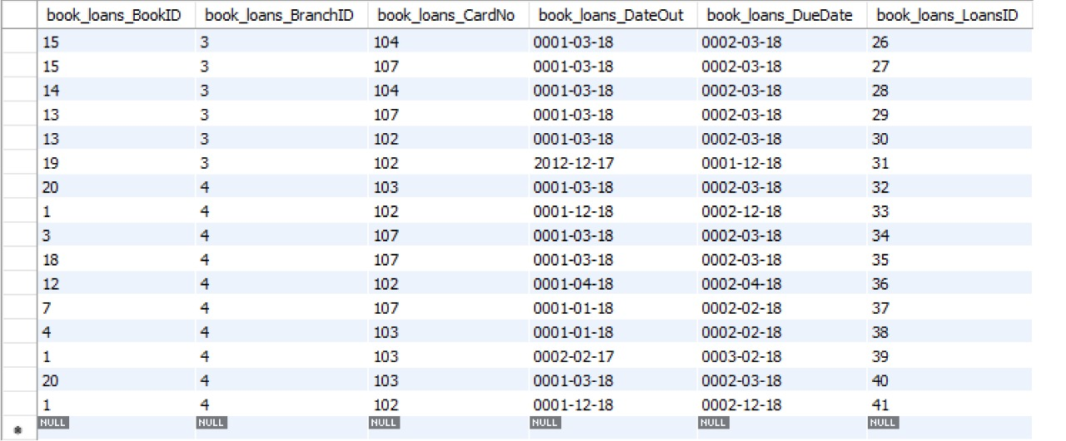
Book Loans

Slide 8
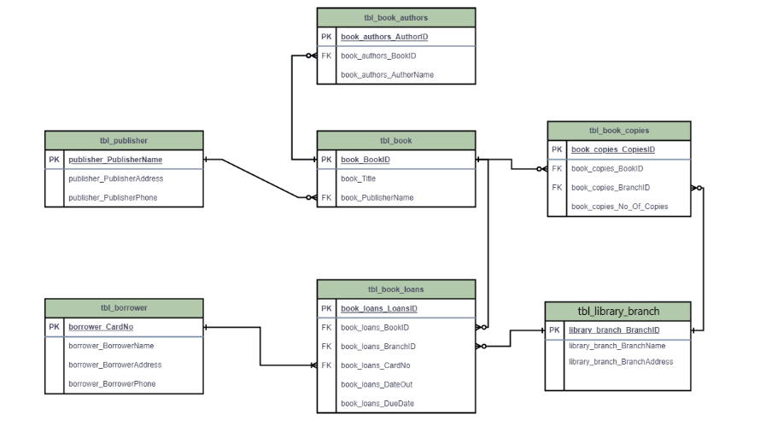
ER Diagram

Slide 9
Problem Statement
Public libraries manage a large collection of books across multiple branches. Each branch must keep track of the books it owns, the number of copies available, and details of borrowers and loans. Managing this information manually often leads to inefficiencies, data inconsistency, and difficulty in retrieving insights such as book availability, author-wise inventory, and loan history.

Slide 10
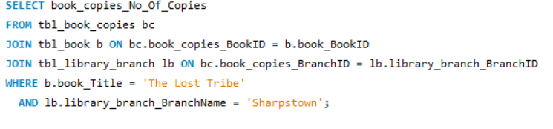

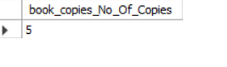
Q1:How many copies of the book titled "The Lost Tribe" are owned by the library branch whose name is "Sharpstown"?

Slide 11
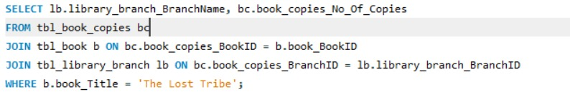
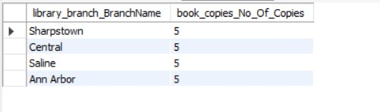

Q2:How many copies of the book titled "The Lost Tribe" are owned by each library branch?

Slide 12
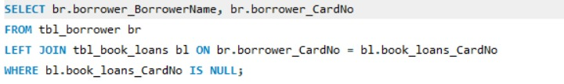
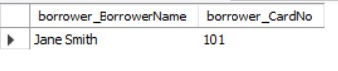

Q3:Retrieve the names of all borrowers who do not have any books checked out.

Slide 13
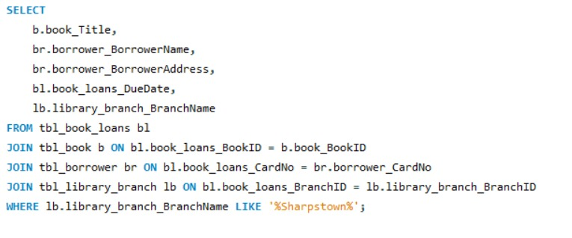
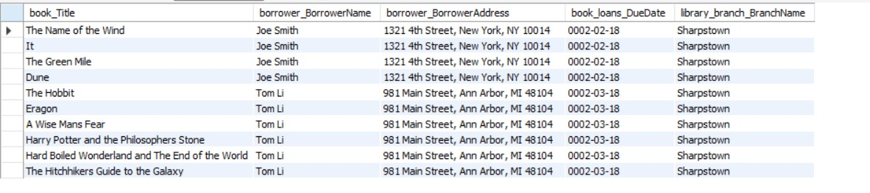

Q4:For each book that is loaned out from the "Sharpstown" branch and whose DueDate is 2/3/18, retrieve the book title, the borrower's name, and the borrower's address.

Slide 14
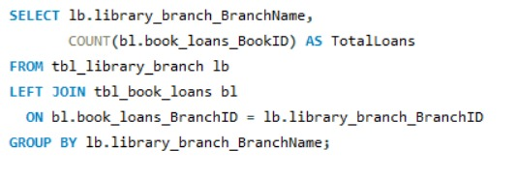

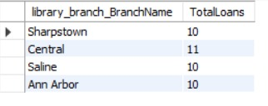
Q5:For each library branch, retrieve the branch name and the total number of books loaned out from that branch.

Slide 15
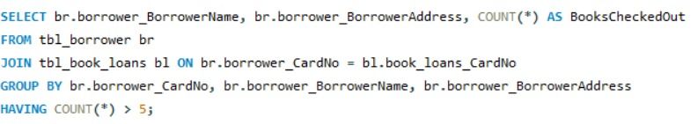
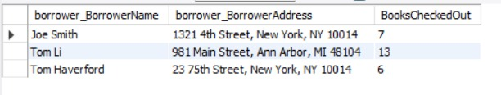

Q6:Retrieve the names, addresses, and number of books checked out for all borrowers who have more than five books checked out.

Slide 16
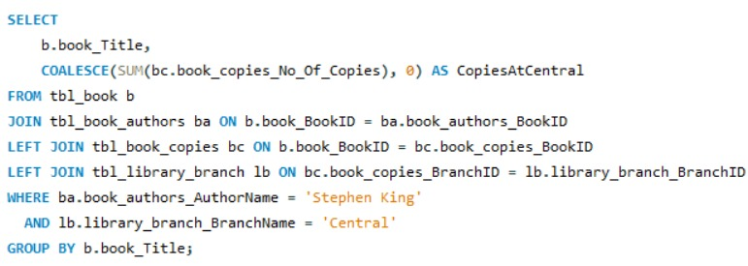

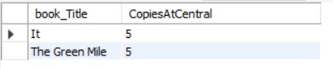
Q7:For each book authored by "Stephen King", retrieve the title and the number of copies owned by the library branch whose name is "Central".

Slide 17


THANK YOU
Presented By:
M.Ravindra Bhaskar
R.Vamsi Krishna

